Slide 1

COMPUTER ORGANIZATION AND ARCHITECTURE
Y.Madhu Babu
Asst. Professor
Dept. of EECE, GIT
Visakhapatnam
myalaka@gitam.edu

Slide 2
UNIT IV
Input-Output Organization
Peripheral devices
I/O Interface
Asynchronous Data Transfer
Modes of Transfer
Priority Interrupt
DMA
I/O Processor
Serial Communication.

Slide 3
Peripheral Devices
Devices that are under direct control of computer are said to be connected on-line.
Input or output devices attached to the computer are also called peripherals.
There are three types of peripherals :
Input peripherals
Output peripherals
Input-output peripherals
Peripheral (or I/O Device)
Monitor (Visual Output Device) : CRT, LCD
KeyBoard (Input Device) : light pen, mouse, touch screen, joy stick
Printer (Hard Copy Device) : Daisy wheel, dot matrix and laser printer
Storage Device : Magnetic tape, magnetic disk

Slide 4
Peripheral Devices
Input Devices:
Keyboard
Optical input devices
Card Reader
Paper Tape Reader
Bar code reader
Optical Mark Reader
Magnetic Input Devices
Magnetic Stripe Reader
Screen Input Devices
Touch Screen
Light Pen
Mouse
Output Devices:
Card Puncher, Paper Tape Puncher
CRT
Printer (Daisy Wheel, Dot Matrix, Laser)
Plotter

Slide 5
I/O Interface
Provides a method for transferring information between internal storage (such as memory and CPU registers) and external I/O devices.
They are special hardware components between CPU and peripheral to supervise and synchronize all input and output transfer.
They are called interface units because they interface between the processor bus and the peripheral device.

Slide 6
I/O Interface
Resolves the differences between the computer and peripheral devices
(1). Peripherals – Electromechanical or Electromagnetic Devices
CPU or Memory - Electronic Device
– Conversion of signal values required
(2). Data Transfer Rate
• Peripherals - Usually slower
• CPU or Memory - Usually faster than peripherals
– Some kinds of Synchronization mechanism may be needed
(3). Data formats or Unit of Information
• Peripherals – Byte, Block, …
• CPU or Memory – Word
(4). Operating modes of peripherals may differ
• must be controlled so that not to disturbed other peripherals connected to CPU

Slide 7
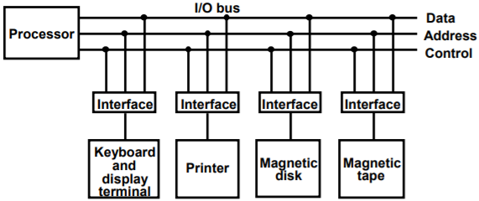
I/O Bus and Interface
Interface:
Decodes the device address (device code)
Decodes the commands (operation)
Provides signals for the peripheral controller
Synchronizes the data flow and supervises the transfer rate between peripheral and CPU or Memory
4 types of command interface can receive : control, status, data o/p and data i/p

Slide 8
I/O Commands
I/O Command is an instruction that is executed in the interface and its attached peripheral units.
Control command : is issued to activate peripheral and to inform what to do
Status command : used to test various status condition in the interface and the peripherals
Data o/p command : causes the interface to respond by transferring data from the bus into one of its registers
Data i/p command : interface receives an item of data from the peripheral and places it in its buffer register.

Slide 9
I/O Bus and Memory Bus
Functions of Buses:
MEMORY BUS is for information transfers between CPU and the MM
I/O BUS is for information transfers between CPUand I/O devices through their I/O interface
Three ways , bus can communicate with memory and I/O:
(1). use two separate buses, one to communicate with memory and the other with I/O interfaces
(2). Use one common bus for memory and I/O but separate control lines for each
(3). Use one common bus for memory and I/O with common control lines for both

Slide 10
Isolated vs. Memory Mapped I/O
Isolated I/O:
Many computers use common bus to transfer information between memory or I/O.
Separate I/O read/write control lines in addition to memory read/write control lines
Separate (isolated) memory and I/O address spaces
Distinct input and output instructions - each associated with address of interface register
Memory-mapped I/O:
A single set of read/write control lines -no distinction between memory and I/O transfer
Memory and I/O addresses share the common address space - reduces memory address range available
No specific input or output instruction - The same memory reference instructions can be used for I/O transfers
Considerable flexibility in handling I/O operations

Slide 11
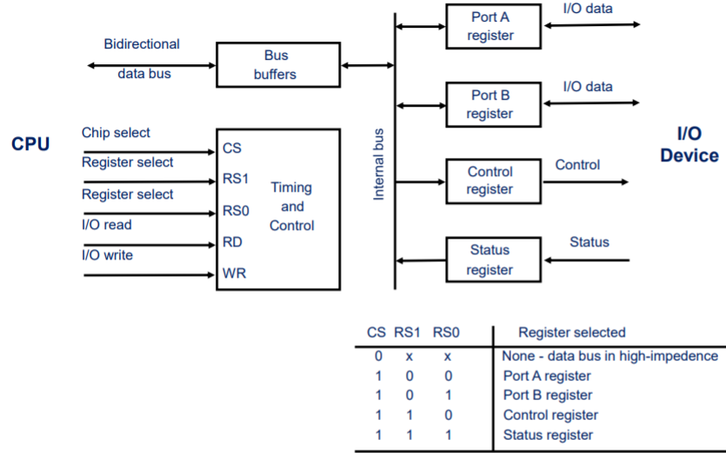
Example of I/O Interface

Slide 12
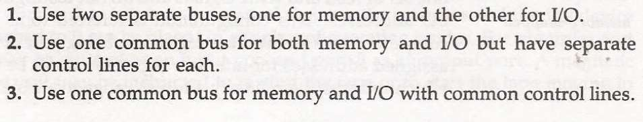
IO versus Memory bus
Like IO bus Memory bus also contain data, address and control lines.
There are 3 ways in which computer bus communicates with memory and IO.

Slide 13
In the first method, CPU has independent set of buses for both memory and IO. It is done in computers that has separate IOP and CPU.
In second method computers use common bus to transfer data between IO or memory and CPU. And separate read and write lines.
IO read/write is enabled during IO transfer and memory read/write is enabled during memory transfer.

Slide 14
This configuration isolates all I/O interface address with the memory address and is referred to as Isolated IO method.
In third method same address space is used for both memory and IO interface. They have only one set of read and write signals.
Computer treats interface as being part of the memory system.

Slide 15
It assign address for each interface which cannot be used for memory words.
This configuration is referred to as memory- mapped IO.

Slide 16
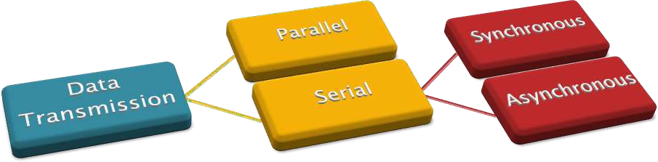
Data transmission (i.e., from source to destination ) can be done either Parallel or Serial.
In Parallel data transmission , the sequence of data can be transmitted parallel at a time .

Slide 17
Parallel Vs Serial transmission
The transfer of data between two units is serial or parallel.
In parallel data transmission, n bit in the message must be transmitted through n separate conductor path.
In serial transmission, each bit in the message is sent in sequence one at a time.
Parallel transmission is faster but it requires many wires. It is used for short distances and where speed is important.
Serial transmission is slower but is less expensive.

Slide 18
Asynchronous Data Transfer
Synchronous Data Transfer
The device which sends data & the device which receives data are synchronized with the same clock.
Data transfer is not based on the predetermined timing pattern.
This technique of data transfer is used , when the speed of an I/O device is not match with the speed of CPU & the timing characteristics of I/O device is not predictable.

Slide 19
Asynchronous Data Transfer
The internal operations in a digital system are synchronized by means of clock pulses supplied by a common pulse generator.
Clock pulses are applied to all registers within a unit and all data transfers among internal registers occur simultaneously during the occurrence of a clock pulse.
Two units, such as a CPU and an IO interface, are designed independently of each other.
If the registers in the interface share a common clock with the CPU registers, the transfer between the two units is said to be synchronous.
In most cases, the internal timing in each unit is independent from the other in that each uses its own private clock for internal registers. In that case, the two units are said to be asynchronous to each other. This approach is widely used in most computer systems.

Slide 20
Asynchronous Data Transfer
Asynchronous Scheme is used when speed of I/O devices do not match with microprocessor, and timing characteristics of I/O devices is not predictable.
In this method, process initiates the device and check its status. As a result, CPU has to wait till I/O device is ready to transfer data. When device is ready CPU issues instruction for I/O transfer.
In this method two types of techniques are used based on signals before data transfer.
1. Strobe Control
2. Handshaking

Slide 21

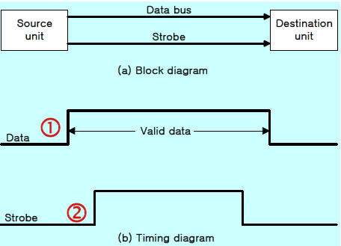
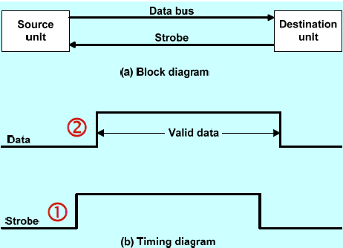
The strobe control method of asynchronous data transfer employs a single control line to time each transfer, which is known as strobe.
It may be achieved either by source or destination.
Source-initiated strobe Destination-initiated strobe

Slide 22
Source-initiated strobe
The data bus carries the binary information from source unit to the destination unit.
The strobe is a single line that informs the destination unit when a valid data word is available in the bus.
The source unit first places the data on the bus.
After a brief delay (to ensure that the data settle to a steady value), the source activates the strobe pulse.
The information of the data bus and the strobe signal remain in the active state for sufficient time period to allow the destination unit to receive the data.
The source removes the data from the bus for a brief period of time after it disables its strobe pulse.

Slide 23
Destination-initiated strobe
The destination unit activates strobe pulse informing the source to provide the data.
The source unit responds by placing the required binary information on the unit to accept it.
The data must be valid and remain in the bus long enough for destination unit to accept it.
The falling edge of strobe pulse can be used again to trigger a destination register.
The destination unit then disables the strobe.
The source removes the data from the bus after a predetermined time interval.

Slide 24
Disadvantage of Strobe Signal
The disadvantage of the strobe method is that, the source unit initiates the transfer has no way of knowing whether the destination unit has actually received the data item that was places in the bus.
Similarly, a destination unit that initiates the transfer has no way of knowing whether the source unit has actually placed the data on bus.
The Handshaking method solves this problem.

Slide 25
Handshaking method
Handshake: Agreement between two independent units
The handshaking method solves the problem of strobe method by introducing a second control signal that provides a reply to the unit that initiates the transfer.
Principle of Handshaking:
One control line is in the same direction as the data flows in the bus from the source to destination. It is used by source unit to inform the destination unit whether there a valid data in the bus.
The other control line is in the other direction from the destination to the source. It is used by the destination unit to inform the source whether it can accept the data.
The sequence of control during the transfer depends on the unit that initiates the transfer.

Slide 26

The Two Handshaking lines generated from the source are
🞄 Data Valid - Source to Destination to inform, whether there are valid data in the bus.
🞄 Data Accept -Destination to source to inform, whether it can accept data.

Slide 27
Block Diagram
Data Bus
Data Valid Data accepted
Destination Unit
Source Unit
Timing Diagram
Data bus
Valid Data
Data valid
Data Accepted

Slide 28





Source
Destination
Place Data on bus Enable data valid
Accept data from bus.
Enable data Accept
Disable data valid
Invalidate data on bus
Disable data accepted Ready to accept data (Initial State)

Slide 29

The source unit initiates the transfer by placing the data on the bus and enabling its data valid signal.
The data accepted signal is activated by the destination unit after it accepts the data from the bus.
The source unit then disable its data valid signal , which invalidates the data on the bus.
The destination unit disable its data accepted signal and the system goes into its initial state.

Slide 30

The two handshaking lines in this scheme are
Data valid
Ready for data
The source unit in this case, does not place data on the bus until after it receives the ready for data signal from the destination unit.

Slide 31
Block Diagram
Data Bus
Data Valid Ready for Data
Destination Unit
Source Unit
Timing Diagram
Ready for data Data valid
Data bus
Valid Data

Slide 32



Destination
Source
Ready to Accept data Enable ready for data
Place Data on bus Enable data valid
Accept data from bus Disable Ready for data
Disable data valid Invalidate data on bus (Initial State)
The handshaking procedure follows the same pattern as in source initiated except the read for data signal has been converted from data accepted in case of source initiated.

Slide 33
Advantage of the Handshaking method
The Handshaking scheme provides degree of flexibility and reliability because the successful completion of data transfer relies on active participation by both units.
If any of one unit is faulty, the data transfer will not be completed. Such an error can be detected by means of a Timeout mechanism which provides an alarm if the data is not completed within time.
Timeout : If the return handshake signal does not respond within a given time period, the unit assumes that an error has occurred.

Slide 34
Parallel Vs Serial transmission
The transfer of data between two units is serial or parallel.
In parallel data transmission, n bit in the message must be transmitted through n separate conductor path.
In serial transmission, each bit in the message is sent in sequence one at a time.
Parallel transmission is faster but it requires many wires. It is used for short distances and where speed is important.
Serial transmission is slower but is less expensive.

Slide 35
Asynchronous Serial Transfer
Synchronous transmission:
The two units share a common clock frequency
Bits are transmitted continuously at the rate dictated by the clock pulses
Asynchronous transmission:
Special bits are inserted at both ends of the character code
Each character consists of three parts :
1) start bit : always “0”, indicate the beginning of a character
2) character bits : data
3) stop bit : always “1”

Slide 36
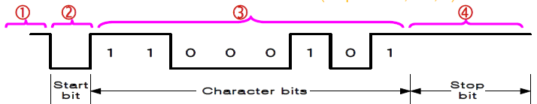
Asynchronous Transfer
Asynchronous transmission rules: no parity
When a character is not being sent, the line is kept in the 1-state
The initiation of a character transmission is detected from the start bit, which is always “0”
The character bits always follow the start bit
After the last bit of the character is transmitted, a stop bit is detected when the line returns to the 1-state for at least one bit time (stop bits : 1, 1.5, 2)

Slide 37
Asynchronous Transfer
terminal → keyboard and a printer
Keyboard → When a key is pressed, the terminal sends 1 1 bits serially along a wire.
Printer → To print a character in the printer, an 11-bit message must be received along another wire.
The terminal interface consists of a transmitter and a receiver.
The transmitter accepts an 8-bit character from the computer and proceeds to send a serial 11-bit message into the printer line.
The receiver accepts a serial 11-bit message from the keyboard line and forwards the 8-bit character code into the computer.
Integrated circuit → provide the interface between computer and similar interactive terminals. → asynchronous communication interface or a universal asynchronous receiver transmitter (UART).
Consider a terminal transfer rate is 10 char/sec.
1 char → 0.1 sec
Each char has 1)1 start bit
2) 8 bit data
3) 2 stop bit : always “1”
11 – bits
1 char → 0.1 sec → 11 bits
1 bit → ? ( 9.090 msec)
baud rate → the rate at which serial information is transmitted and is equivalent to the data transfer in bits per second.
Baud rate = 11bits / 0.1 sec = 110 bits / sec

Slide 38
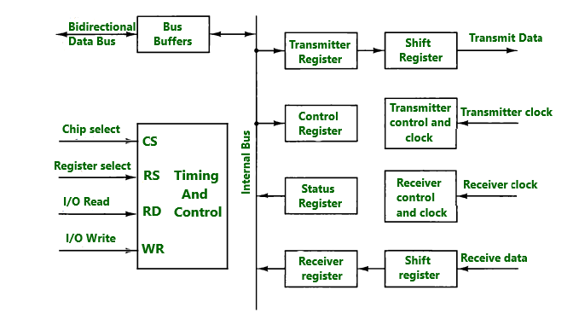
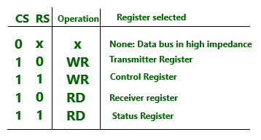
Asynchronous Communication Interface
It works as both a receiver and a transmitter. Its operation is initialized by CPU by sending a byte to the control register.
The transmitter register accepts a data byte from CPU through the data bus and transferred to a shift register for serial transmission.
The receive portion receives information into another shift register, and when a complete data byte is received it is transferred to receiver register.
CPU can select the receiver register to read the byte through the data bus. Data in the status register is used for input and output flags.

Slide 39
Modes of Data Transfer
Transfer of data is required between CPU and peripherals or memory or sometimes between any two devices or units of your computer system.
To transfer a data from one unit to another one should be sure that both units have proper connection and at the time of data transfer the receiving unit is not busy.
All the internal operations in a digital system are synchronized by means of clock pulses supplied by a common clock pulse Generator.
The data transfer can be
i. Synchronous
ii. Asynchronous

Slide 40
Modes of Data Transfer
When both the transmitting and receiving units use same clock pulse then such a data transfer is called Synchronous process.
On the other hand, if the there is not concept of clock pulses and the sender operates at different moment than the receiver then such a data transfer is called Asynchronous data transfer.
The data transfer can be handled by various modes. some of the modes use CPU as an intermediate path, others transfer the data directly to and from the memory unit
Three modes of data transfer:
i. Programmed I/O
ii. Interrupt-Initiated I/O
iii. Direct Memory Access (DMA)

Slide 41
Programmed I/O Mode
Programmed I/O operations are the result of I/O instructions written in the computer program.
Each data transfer is initiated by a instruction in the program.
Normally the transfer is from a CPU register to peripheral device or vice-versa.
Once a data is initiated the CPU starts monitoring the interface to see when next transfer can made.
The instructions of the program keep close tabs on everything that takes place in the interface unit and the I/O devices.

Slide 42
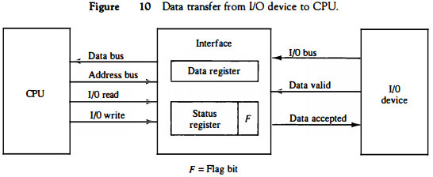
Programmed I/O Mode
In the programmed I/O method, the I/O device does not have direct access to memory.
A transfer from an I/O device to memory requires the execution of several instructions by the CPU, including an input instruction to transfer the data from the device to the CPU and a store instruction to transfer the data from the CPU to memory.
Other instructions may be needed to verify that the data are available from the device and to count the numbers of words transferred.

Slide 43
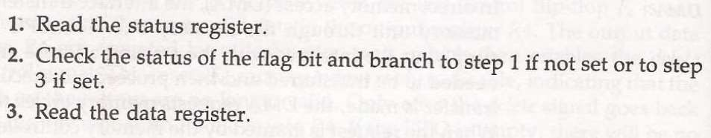
Each data transfer is initiated by an instruction in the program.
CPU stays in the program loop until IO unit indicates it is ready for the data transfer.
It is time consuming process since it keeps processor busy needlessly.
The transfer of data requires three instructions:

Slide 44
Programmed I/O Mode
When a byte of data is available, the device places it in the I/O bus and enables its data valid line.
The interface accepts the byte into its data register and enables the data accepted line. The interface sets a bit in the status register that we will refer to as an F or "flag" bit.
The device can now disable the data valid line, but it will not transfer another byte until the data accepted line is disabled by the interface.
A program is written for the computer to check the flag in the status register to determine if a byte has been placed in the data register by the I/O device.
If the flag is equal to 1, the CPU reads the data from
the data register. The flag bit is then cleared to 0
Once the flag is cleared, the interface disables the
data accepted line and the device can then
transfer the next data byte.
Notes:
When a byte of data is available, the device places it in
the VO bus and enables its data valid line. The interface accepts the byte into
its data register and enables the data accepted line. The interface sets a bit in
the status register that we will refer to as an F or "flag" bit. The device can now
disable the data valid line, but it will not transfer another byte until the data
accepted line is disabled by the interface.

Slide 45
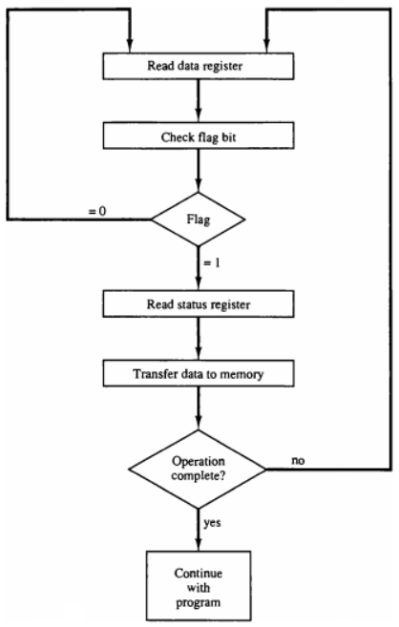
Programmed I/O Mode
The transfer of each byte requires three instructions:
1. Read the status register.
2. Check the status of the flag bit and branch to step 1 if not set or to step 3 if set.
3. Read the data register.
Each byte is read into a CPU register and then transferred to memory with a store instruction.
The programmed IO method is particularly useful in small low-speed computers or in systems that are dedicated to monitor a device continuously.
The difference in information transfer rate between the CPU and the I/O device makes this type of transfer inefficient.

Slide 46
Drawback of the Programmed I/O
The main drawback of the Program Initiated I/O was that the CPU has to monitor the units all the times when the program is executing. Thus the CPU stays in a program loop until the I/O unit indicates that it is ready for data transfer.
This is a time consuming process and the CPU time is wasted a lot in keeping an eye to the executing of program.
To remove this problem an Interrupt facility and special commands are used

Slide 47
Interrupt-Initiated I/O
In this method an interrupt facility an interrupt command is used to inform the device about the start and end of transfer.
In the meantime the CPU executes other program.
When the interface determines that the device is ready for data transfer it generates an Interrupt Request and sends it to the computer.
When the CPU receives such an signal, it temporarily stops the execution of the program and branches to a service program to process the I/O transfer and after completing it returns back to task, what it was originally performing.

Slide 48
Interrupt-Initiated I/O
In this type of IO, computer does not check the flag. It continue to perform its task.
Whenever any device wants the attention, it sends the interrupt signal to the CPU.
CPU then deviates from what it was doing, store the return address from PC and branch to the address of the subroutine.
There are two ways of choosing the branch address:
Vectored Interrupt → In vectored interrupt the source that interrupt the CPU provides the branch information. This information is called interrupt vectored.
Non-vectored Interrupt → In non-vectored interrupt, the branch address is assigned to the fixed address in the memory.

Slide 49
Priority Interrupt
There are number of IO devices attached to the computer.
They are all capable of generating the interrupt.
When the interrupt is generated from more than one device, priority interrupt system is used to determine which device is to be serviced first.
Devices with high speed transfer are given higher priority and slow devices are given lower priority.
Establishing the priority can be done in two ways:
1. Using Software
2. Using Hardware
A polling procedure is used to identify highest priority in software means.

Slide 50
Polling Procedure
A polling procedure is used to identify the highest-priority source by software means.
There is one common branch address for all interrupts.
Branch address contain the code that polls the interrupt sources in sequence. The highest priority is tested first.
The particular service routine of the highest priority device is served.
The disadvantage is that time required to poll them can exceed the time to serve them in large number of IO devices.

Slide 51
Using Hardware
It accepts interrupt requests from many sources, determines which of the incoming requests has the highest priority, and issues an interrupt request to the computer based on this determination.
To speed up the operation, each interrupt source has its own interrupt vector to access its own service routine directly.
Thus no polling is required because all the decisions are established by the hardware priority-interrupt unit.
The hardware priority function can be established by either a serial or a parallel connection of interrupt lines.
The serial connection is also known as the daisy-chaining method.

Slide 52
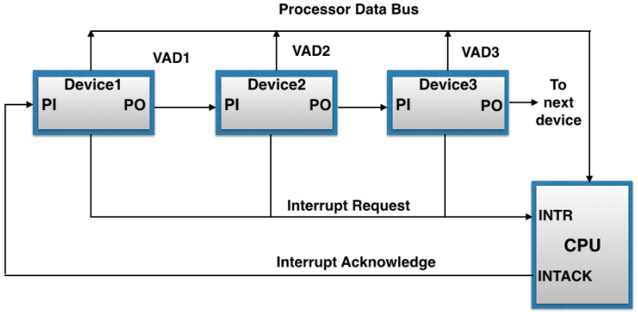
Serial or Daisy-Chaining Priority
Device with highest priority is placed first.
Device that wants the attention send the interrupt request to the CPU.
CPU then sends the INTACK signal which is applied to PI(priority in) of the first device.
If it had requested the attention, it place its VAD(vector address) on the bus. And it block the signal by placing 0 in PO(priority out)
If not it pass the signal to next device through PO(priority out) by placing 1.
This process is continued until appropriate device is found.
The device whose PI is 1 and PO is 0 is the device that send the interrupt request.

Slide 53
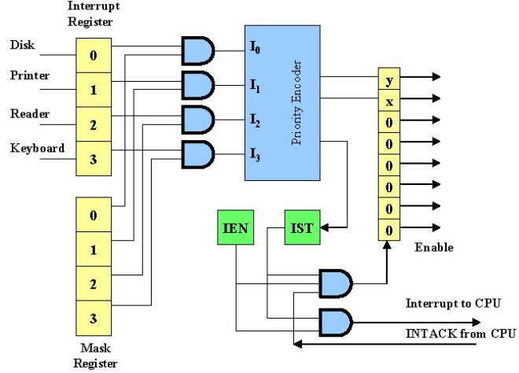
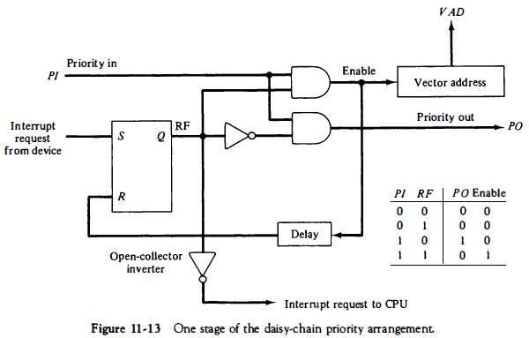
Parallel Priority Interrupt

Slide 54
Interrupt Cycle
During the interrupt cycle the CPU performs the following sequence of microoperations:
SP +- SP – 1 Decrement stack pointer
M[SP] +-PC Push PC into stack
INTACK <--1 Enable interrupt acknowledge
PC <- VAD Transfer vector address to PC
lEN <--0 Disable further interrupts
Go to fetch next instruction

Slide 55
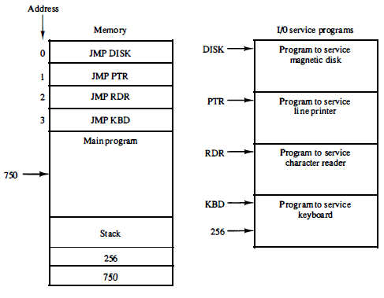
Software Routines
The computer must have software routines for servicing the interrupt requests and for controlling the interrupt hardware registers.

Slide 56
Initial and Final Operations
The initial sequence of each interrupt service routine must have instructions to control the interrupt hardware in the following manner:
1. Clear lower-level mask register bits.
2. Clear interrupt status bit !ST.
3. Save contents of processor registers.
4. Set interrupt enable bit lEN.
5. Proceed with service routine.
The final sequence in each interrupt service routine must have instructions to control the interrupt hardware in the following manner:
1. Gear interrupt enable bit lEN.
2. Restore contents of processor registers.
3. Clear the bit in the interrupt register belonging to the source that has
been serviced.
4. Set lower-level priority bits in the mask register.
5. Restore return address into PC and set lEN.
The initial and final operations listed above are referred to as overhead operations or housekeeping chores.

Slide 57
Direct Memory Access (DMA)
In the Direct Memory Access (DMA) the interface transfer the data into and out of the memory unit through the memory bus.
The transfer of data between a fast storage device such as magnetic disk and memory is often limited by the speed of the CPU.
Removing the CPU from the path and letting the peripheral device manage the memory buses directly would improve the speed of transfer. This transfer technique is called Direct Memory Access (DMA).
During the DMA transfer, the CPU is idle and has no control of the memory buses.
A DMA Controller takes over the buses to manage the transfer directly between the I/O device and memory.

Slide 58
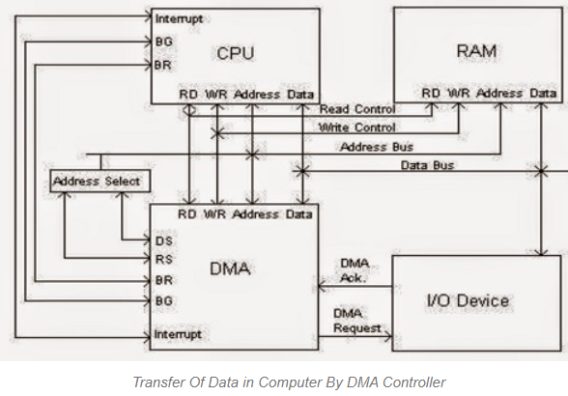
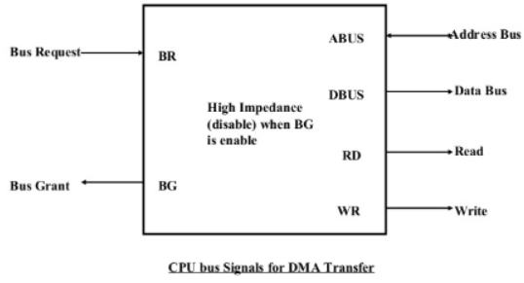
Direct Memory Access (DMA)
The CPU may be placed in an idle state in a variety of ways. One common method extensively used in microprocessor is to disable the buses through special control signals such as Bus Request (BR) Bus Grant (BG)

Slide 59
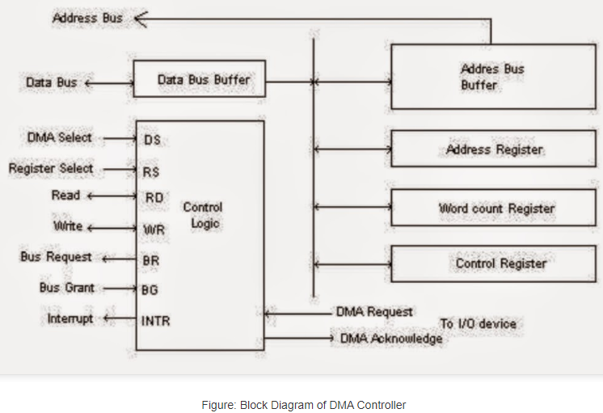
Direct Memory Access (DMA)

Slide 60
Direct Memory Access (DMA)
The CPU initializes the DMA by sending the given information through the data bus.
The starting address of the memory block where the data is available (to read) or where data are to be stored (to write).
It also sends word count which is the number of words in the memory block to be read or write.
Control to define the mode of transfer such as read or write.
A control to begin the DMA transfer.

Slide 61
Cycle Stealing and Burst Modes
DMA controllers can operate in a cycle stealing mode in which they take over the bus for each byte of data to be transferred and then return control to the CPU.
They can also operate in burst mode in which a block of data is transferred before returning bus control to the CPU.
The choice depends on the speed at which data is arriving relative to the bus bandwidth and whether a particular application will allow the CPU to be locked off the bus for the duration of one transfer.

Slide 62
Input-Output Processor(IOP)
It is a processor with direct memory access capability that communicates with IO devices.
IOP is similar to CPU except that it is designed to handle the details of IO operation.
Unlike DMA which is initialized by CPU, IOP can fetch and execute its own instructions.
IOP instruction are specially designed to handle IO operation.

Slide 63
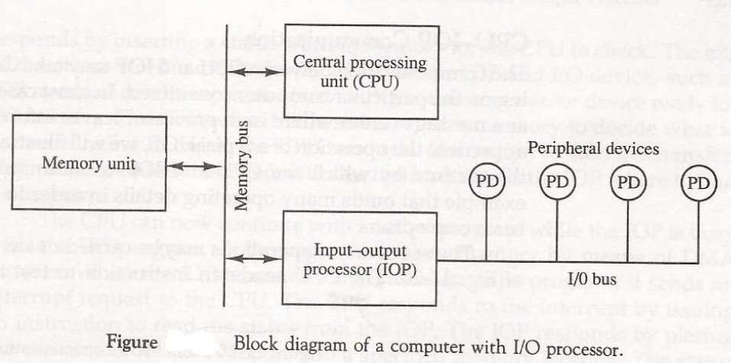
IOP

Slide 64
IOP
Memory occupies the central position and can communicate with each processor by DMA.
CPU is responsible for processing data.
IOP provides the path for transfer of data between various peripheral devices and memory.
Data formats of peripherals differ from CPU and memory. IOP maintain such problems.
Data are transfer from IOP to memory by stealing one memory cycle.

Slide 65
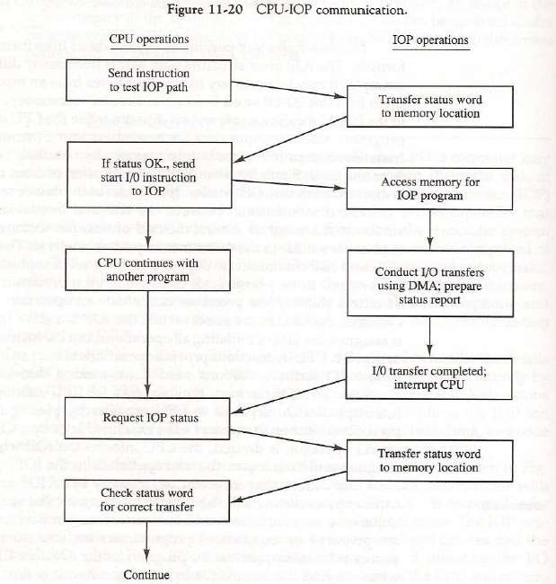
IOP
Instructions that are read from memory by IOP are called commands to distinguish them from instructions that are read by the CPU.

Slide 66
Serial Communication
1. Character-Oriented Protocol
2.Transmission Example
3.Data Transparency
4.Bit-Oriented Protocol

Slide 67
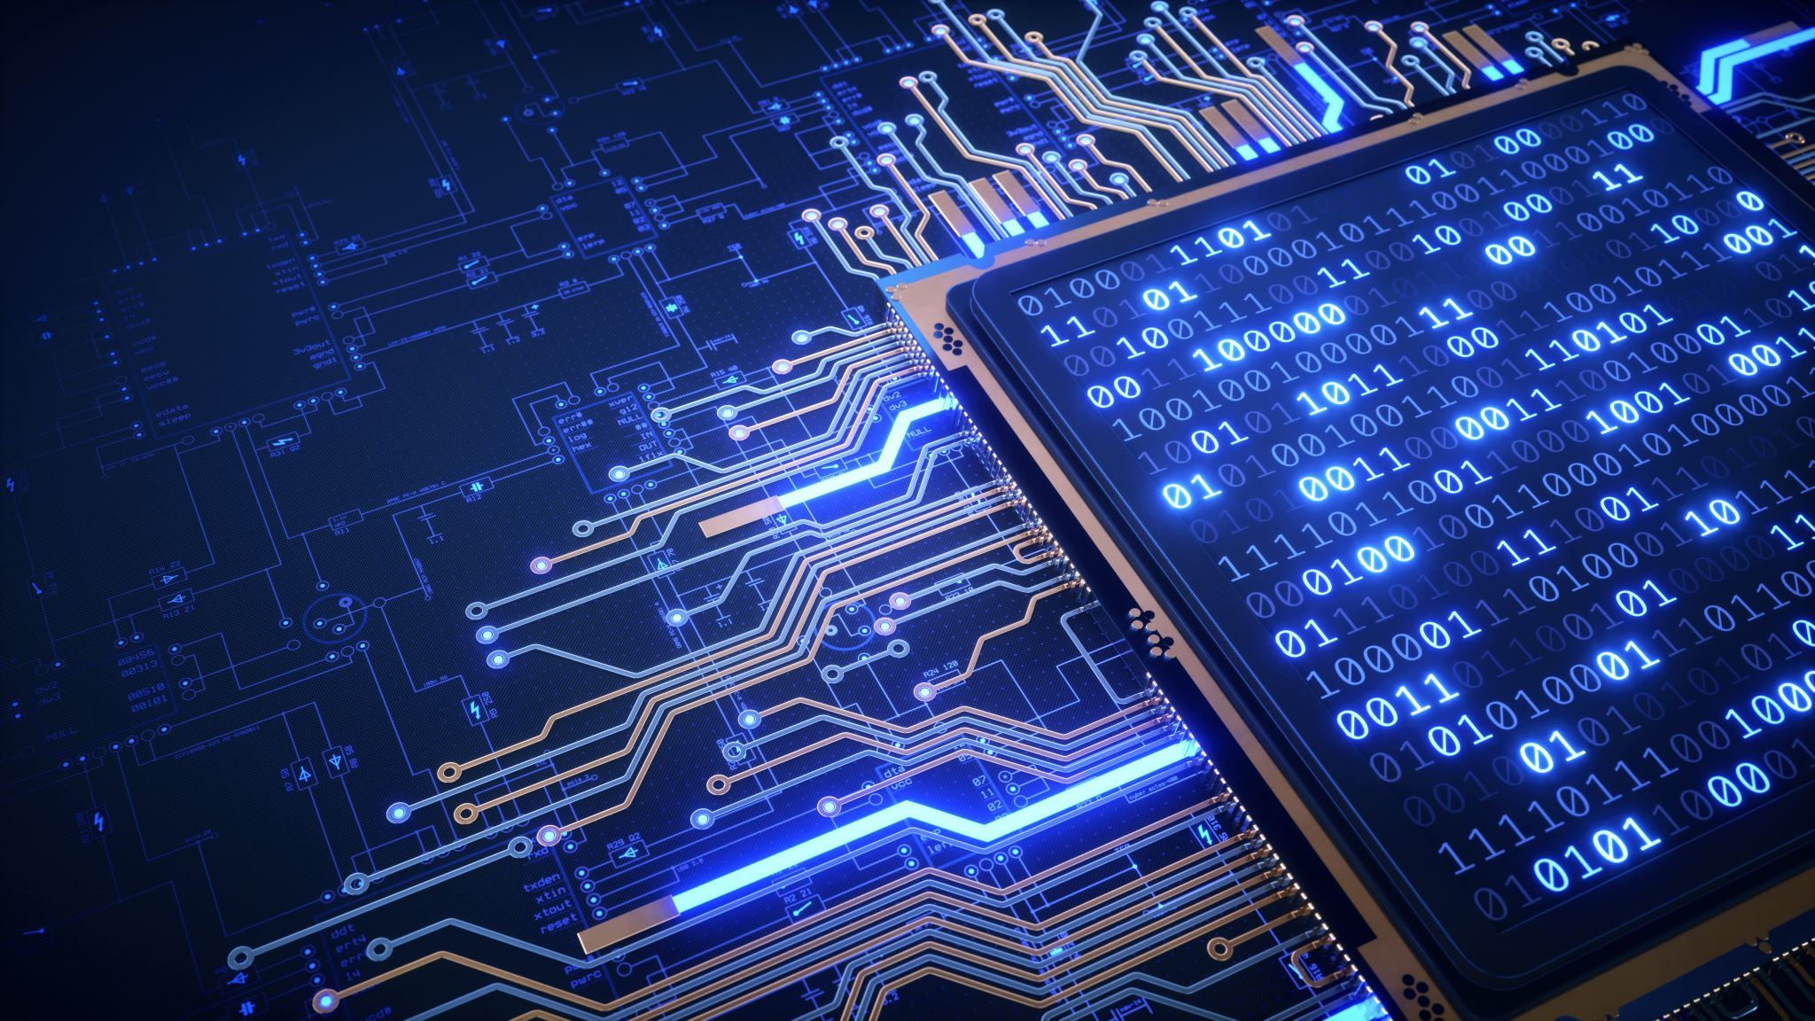
Serial Communication
A data communication processor is an I/O processor that distributes and collects data from many remote terminals connected through telephone and other communication lines.
It is a specialized processor designed to communicate directly with data communication networks.
A communication network may consist of any of a wide variety of devices, such as printers, interactive display devices, digital sensors, or a remote computing facility.
The most striking difference between an I/O processor and a data communication processor is in the way the processor communicates with the I/O devices.

Slide 68
An I/O processor communicates with the peripherals through a common I/O bus that is comprised of many data and control lines. All peripherals share the common bus and use it to transfer information to and from the I/O processor.
A data communication processor communicates with each terminal through a single pair of wires. Both data and control information are transferred in a serial fashion with the result that the transfer rate is much slower.
The task of the data communication processor is to transmit and collect digital information to and from each terminal, determine if the information is data or control and respond to all requests according to predetermined established procedures.

Slide 69
The way that remote terminals are connected to a data communication processor is via telephone lines or other public or private communication facilities.
Since telephone lines were originally designed for voice communication and computers communicate in terms of digital signals, some form of conversion must be used. The converters are called data sets, acoustic couplers,modem or modems (from "modulator-demodulator").
A modem converts digital signals into audio tones to be transmitted over telephone lines and converts audio tones from the line to digital signals for machine use.

Slide 70
A communication line may be connected to a synchronous or asynchronous interface, depending on the transmission method of the remote terminal.
An asynchronous interface receives serial data with start and stop bits in each character.
Synchronous transmission does not use start-stop bits to frame characters and therefore makes more efficient use of the communication link.
In synchronous transmission, where an entire block of characters is transmitted, each character has a parity bit for the receiver to check.
After the entire block is sent, the transmitter sends one more character that constitutes a parity over the length of the message. This character is called a longitudinal redundancy check (LRC).

Slide 71
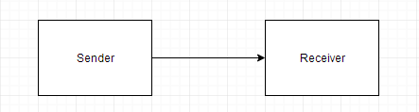
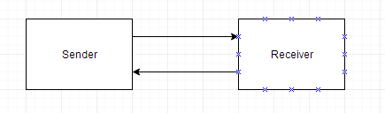
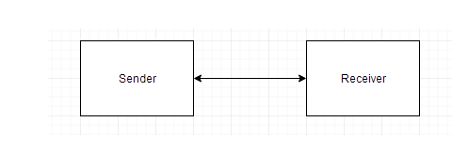
Another method used for checking errors in transmission is the cyclic redundancy check (CRC).
Data can be transmitted between two points in three different modes: simplex, half-duplex, or full-duplex.
A simplex line carries information in one direction only.
Examples of simplex transmission are radio and television broadcasting.
A half-duplex transmission system is one that is capable of transmitting in both directions, but data can be transmitted in only one direction at a time. For example: Walkie - Talkie.
A full-duplex transmission can send and receive data in both directions simultaneously.
For example: Video Calling, Audio calling etc.

Slide 72
What are Protocols?
The communication lines, modems and other devices used in any transmission are collectively called a Data Link. The orderly transmission of data in a data link can be accomplished by a protocol.
A Protocol is a set of rules that are followed by interconnecting devices to ensure that all data is passed correctly without any error.
Types of Protocols:
Character Oriented Protocol
Bit Oriented Protocol

Slide 73
Character Oriented Protocol:
It is based on the binary code of character set. The code is mostly used in ASCII. It includes upper case and lower case letters, numerals and variety of special symbols.
The characters that control the transmission is called communication control characters.
Bit Oriented Protocol:
1.It does not use characters in its control field and is independent of any code. It allows the transmission of serial bit stream of any length without the implication of character boundaries
2.Messages are organized in a specific format called a frame.
3. The frame boundaries are determined from a special S-bit number called a flag.

Slide 74
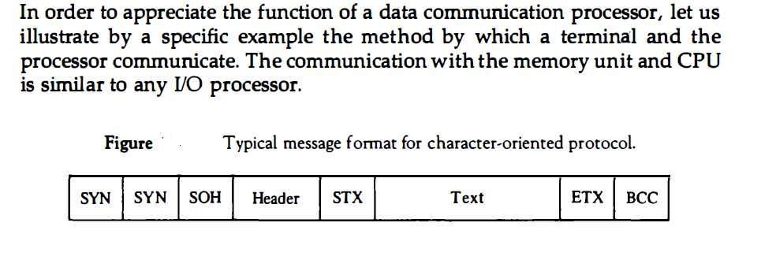

Slide 75
Examples of bit-oriented protocols are SDLC (synchronous data link control) used by IBM, HDLC (high-level data link control) adopted by the International Standards Organization, and ADCCP (advanced data communication control procedure) adopted by the American National Standards Institute.
The station that has responsibility for the data link and issues the commands to control the link is called the primary station.
Bit-oriented protocols assume the presence of one primary station and one or more secondary stations.
All communication on the data link is from the primary station to one or more secondary stations, or from a secondary station to the primary station.

Slide 76
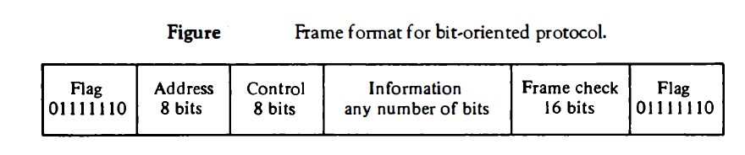
To prevent a flag from occurring in the middle of a frame, the bit-oriented protocol uses a method called zero insertion . This requires that a 0 be inserted by the transmitting station after any succession of five continuous 1' s.

Slide 77
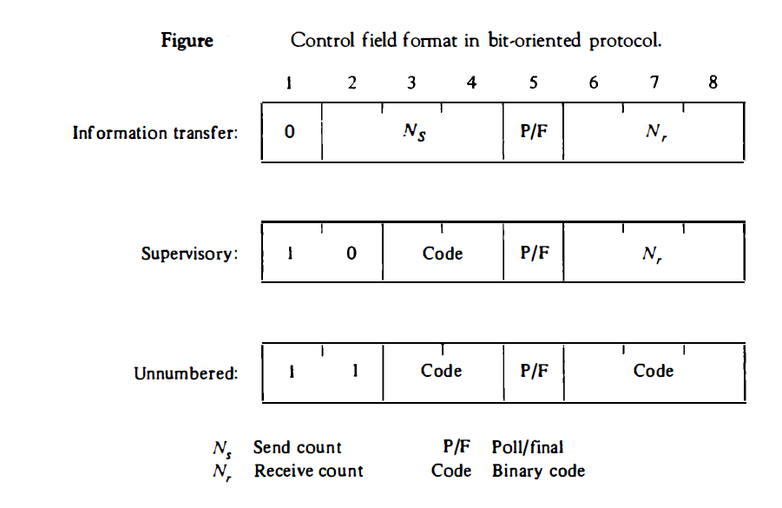

Slide 78
Thank you

